Slide 1
Modernizing Risk and Compliance with Generative AI
Databricks - Morgan Stanley - RBC
OSSF - NYC
Nov. 2023

Slide 2







Speakers
Michael Shtelma
Lead Specialist Solution Architect - Databricks
Brooke Wenig
AI Practice Lead - Databricks
Kabir Rekhi
Head of Data Architecture - RBC capital markets
Stephen Goldbaum
Distinguished Engineer - Morgan Stanley

Slide 3
Future of compliance
Challenges and opportunities
TODO: Kabir to bring slides if needed
Future of compliance
Current challenges
Future opportunities
Current initiatives
The goal will be to stress the importance of a change in the regulatory technology landscape

Slide 4



Trends driving generative AI adoption
No shortage of possible use cases across Financial Services
Organization change
Generating new revenues
Improving margins
Innovating faster
Paradigm shifts such as open banking are driving need for deeper understanding of their customers, expecting personalized experiences.
Regulatory workloads are becoming too costly to manage and scale, and are often built on brittle infrastructure that lead to compliance challenges.
Invest into unified governance to bring the necessary transparency to the use of AI, its associated risks, and adapt to changing regulations.
Strategic initiatives
Notes:
Regulatory Requirements are creating the Perfect storm for Gen AI.

Slide 5
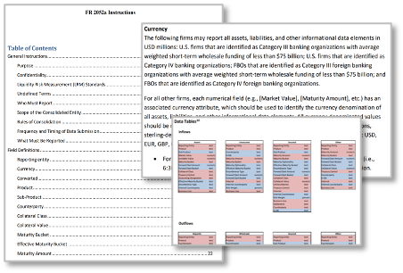
5 main applications of LLMs
Regulatory change has increased 500% since the 2008 global financial crisis. FSI are struggling to keep pace with new regulations like the updated Anti-Money Laundering Act, 2020, FRTB, 2023 and PSD2 in the EU. Not acting as a compliance officer but more as a compliance assistant, LLM could be used to extract relevant sections across a variety of unstructured documents.
80% of use cases are operational efficiency
Sentiment analysis
E.g. route optimization for customer complaints and product recommendation
Document indexing
E.g. replacement of search engines initiatives for internal knowledge base
Text Summarization
E.g. converting market intelligence reports into executive summaries
Entity extraction
E.g. understanding the data dependencies in complex regulatory workflows
Code generation
E.g. translating business logic from one system to another
Could LLMs be used to extract relevant sections across unstructured documents and generate regulatory pipelines?
Notes:
There are multiple applications of LLMs for financial services. Let’s look at some technical capabilities of LLM and see how they might apply to FS.
Specifically, we will look at the last 2, in line with challenges Kabir articulated earlier.
Could LLMs be used to extract relevant sections across unstructured documents and generate regulatory pipelines?

Slide 6
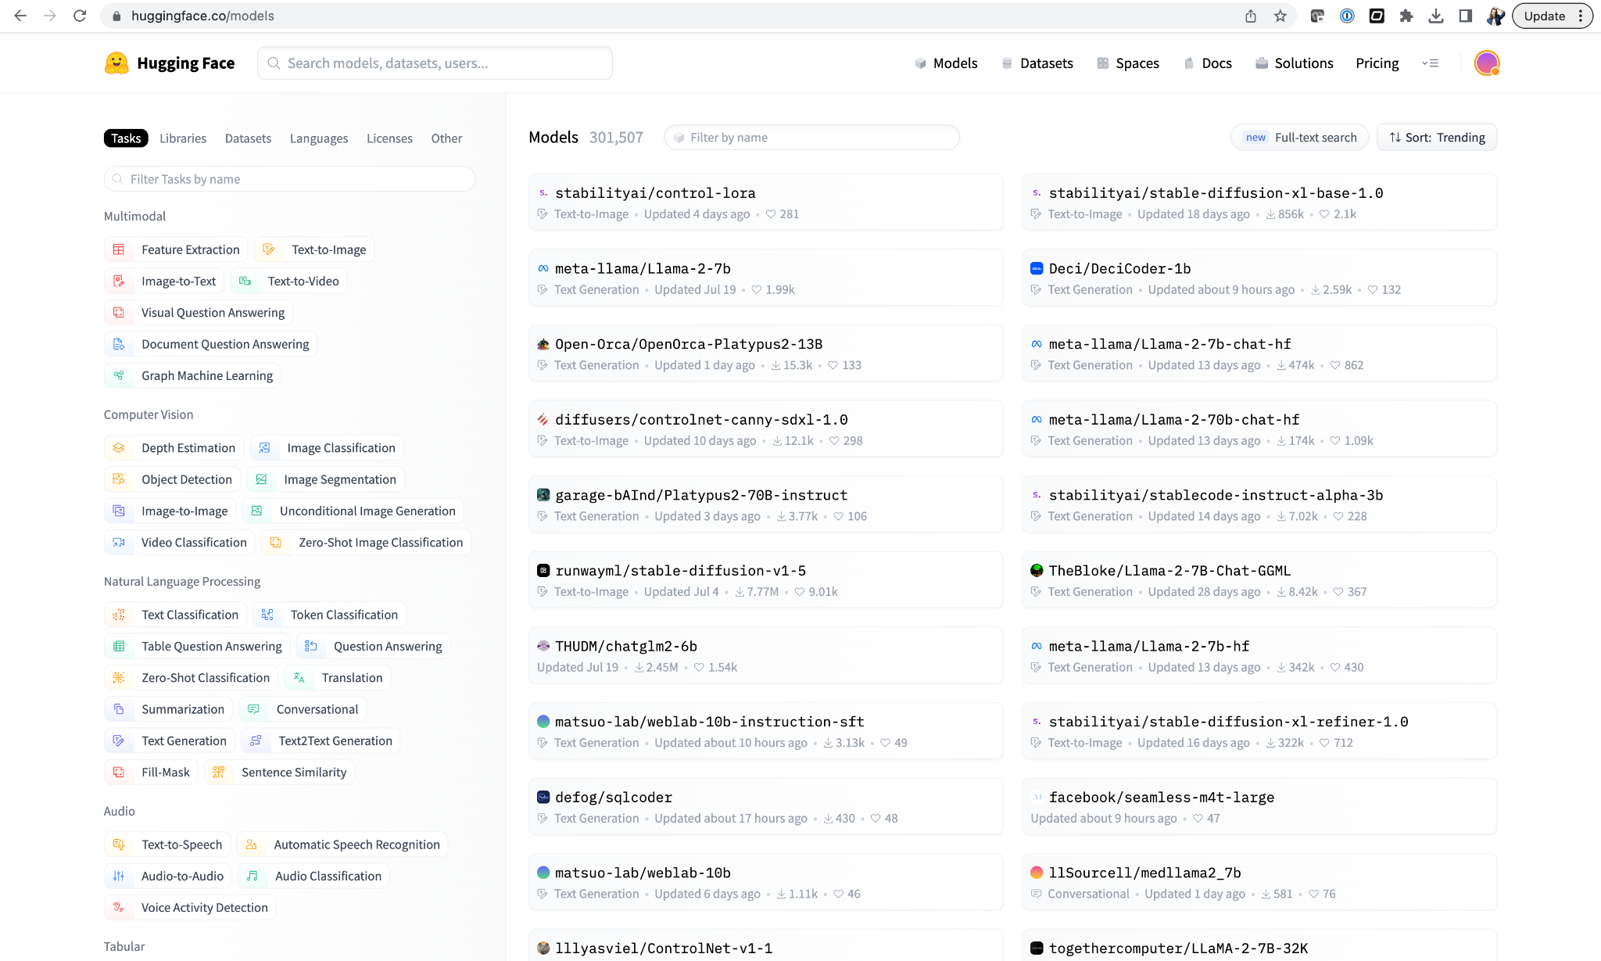
Leading Barriers in Scaling AI Initiatives
Business / Technology
Risk management
New / heightened risks
Model selection
Proprietary / Open source
Bias or poisoning in training data
Sophisticated phishing & deepfakes
Risk of vendor lock in
Misinformation/hallucination
Prompt injection attacks
Exposure of customer data
* Deloitte: https://www2.deloitte.com/content/dam/Deloitte/us/Documents/deloitte-analytics/us-ai-institute-state-of-ai-fifth-edition.pdf
Notes:
LLMs however come as risks. Risks that may be heightened (such as bias or ethics), or new (such as hallucination). We certainly would not want a model to make up regulations.
The second challenge comes with the pace of evolution of LLM. ChatGPT product was announced last year in November, there are 100k models on hugging face already, with different level of quality, lack of governance, lack of data traceability. When everything changes so fast, how do we ensure we have solid foundations for the future?

Slide 7



















Invest in a platform, not into a model
Enabling interoperability of models through open source
MLops + LLMops + DataOps
Shared interfaces and paradigms to deploy data and AI
Deep learning models
Prepare Data
One toolkit for data prep
Develop & Evaluate AI
Tools for every persona
Serve AI
Every model accessible via API, SQL,
or Pipelines
Classical ML algorithms
Serve Data
One platform for real-time data serving
Monitoring
One toolkit for data and AI monitoring
Proprietary LLMs
Unity catalog
One security and governance model for all data and AI across the organization
Open source LLMs
Delta Lake
One platform to store and manage all structured, semi-structured, and unstructured data
MPT
Chains & agents
Cloud Data Lake
All Raw Data
(Logs, Texts, Audio, Video, Images)
Notes:
Let’s look from a technical point of view first (This is the only sales-y slide). When models are changing so fast, today’s best model will become tomorrow’s legacy, so best bet is on open source.
Ability to switch endpoint between different models, proprietary (openai) or open source (llama), combining ML and AI together, etc…

Slide 8

Risks vs. Benefits
Using large language models as your compliance assistant
Benefits
Risks
Improving team productivity and regulatory compliance by scraping all guidelines and policies, asking models for specific regulatory sections or policies a scenario may apply to.
Regulatory compliance does not allow for interpretation. It is key to apply judgement in LLM answers and ask the right question, necessitating human supervision and domain expertise.
Instead of generating and executing regulatory workflows, LLMs could be used to translate regulatory requirements into data models, allowing compliance officers to visualize and test business logic.
Notes:
The second main challenge is not much about technology but about how to apply technology. Whilst the benefits of using LLM for reg reporting are obvious, we briefly covered the risks of a model to “hallucinate”. Risks outweigh the benefits. But we could change the entire dynamics when we do not aim at solving the problem but assisting people, specifically compliance officer. A model could read regulatory specifications and generate the code for a compliance officer to read, interpret and test, leveraging fantastic initiatives like Morphir to do so. In this setup, a model would be considered as your “intern”. We would not want its work to be sent to regulators, but we want his help to build a pipeline.

Slide 9
Morphir overview
Business logic as code
TODO: Stephen to bring slides if needed
What is morphir
Motivations behind Morphir
LCR calculations
Challenges in today’s adoption
The goal will be to stress the importance of community to address this problem of data / test, especially beyond LCR.

Slide 10
Building a compliance assistant
Using off the shelf large foundational models, one can easily extract data domain entities by passing regulations as model context. Challenges around context length (capped to 4k tokens for LLama v2) that prevents us from reading entire regulatory specs.
Visualizing business logic from unstructured documents
Extracting domain entities and their relationships into machine interpretable insights
Open source models initiatives such as Starcoder base learned from online example (github, stack overfow). Good statistical representation for popular languages (e.g. python), model may lack relevance for less represented languages (i.e. elm).
Generating *.elm code to convert domain entities into morphir executable pipelines
Business logic becomes too specific to leverage off the shelf foundational models. We may want to train our own model based on some real Morphir examples.
Generating test data and use cases through reinforcement learning until edge cases can be identified.

Slide 11
Code overview
GenAI for regulatory technology
TODO: Michael to bring screenshot
Just sharing some thoughts, wins, challenges
No need to demo, simple screenshots are enough
The goal will be to show the art of the possible and mention that this is really early stage but with enough help from the open source community, we may address this complex challenge across different regulations.

Slide 12
TODO: Kabir to wrap things up
The goal will be to stress the importance of open source and community, invite audience to join the reg tech motion, and (bonus point), to mention how awesome Databricks is :)

Slide 13


